Slide 1
OCS Advisory Board 2014 Workshop
Presented By: Donna Dixon
Bureau of Ocean Energy Management
U.S. Department of the Interior

Slide 2
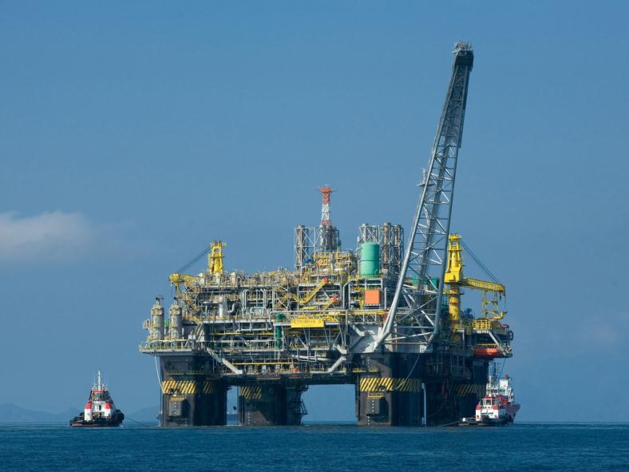
Considerations

Slide 3
Considerations in Developing the Program
Prioritization:
Taking a multi-dimensional look at risk. It’s natural to push certain risks to the top of the priority list. That’s why those with the highest likelihood or greatest potential impact get all the attention. But there are other dimensions to consider when assessing risks
Risks don’t usually unfold in isolation. One risk event can trigger other related risks, contributing to a snowball effect in which different risks become connected and gain momentum, possibly leading to catastrophic events that can persist for long stretches of time
Deloitte
BOEM’s risk management program includes more than just bonding to cover decommissioning; it is intended to include non-payment, non-compliance, engineering, operational and business risk

Slide 4
Considerations in Developing the Program
Probabilities:
Treating root-cause risk drivers. Risk assessment isn’t of much value if the organization fails to adequately prepare for risk events and determine whether additional responses to manage risks are warranted
Treating root-cause drivers can help leaders make big strides toward lowering risk probabilities and minimizing the impact on the organization before a risk event emerges Deloitte
BOEM’s risk management program will augment BOEM’s previously existing processes with proactive systematic risk monitoring

Slide 5
Considerations in Developing the Program
National Commission on Offshore Drilling
Industry developed some new insurance tools and pooling schemes for mitigating financial risks
“Congress and industry are considering a series of more nuanced measures that, while raising the cap, also seek to anticipate and mitigate the potentially adverse impact on the smaller, independent operators in the Gulf…”
National Commission on the BP Deepwater Horizon Oil Spill and Offshore Drilling
30 CFR 556.53 allows the Regional Director to require additional security
30 CFR 556.56 Lease-specific Abandonment Accounts
30 CFR 556.57 Using a Third-party Guarantee instead of a Bond
30 CFR 556.54(e) (3) provides for other “form[s] of security approved by the Regional Director”

Slide 6
Responsibility for Offshore Liabilities
Decommissioning liability varies by type of ownership rights.
Financial liability for end-of-life leasehold costs varies according to statutory or contractual ownership rights and responsibilities
United States has no ownership interest / no decommissioning liability
Historical reliance on concept of “joint and several liability”
30 CFR 556.53(d) requires compliance with all lease obligations
30 CFR 556.53(e) The Regional Director will determine the amount of supplemental bond required to guarantee compliance. The Regional Director will consider potential underpayment of royalty and cumulative obligations to abandon wells, remove platforms and facilities, and clear the seafloor of obstructions in the Regional Director's case-specific analysis

Slide 7
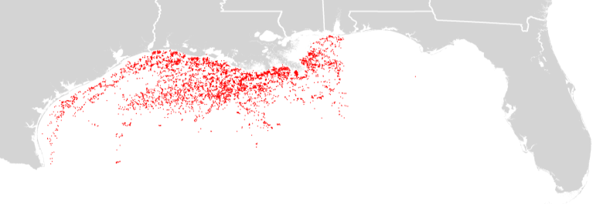
Conventional Energy Infrastructure Management
BOEM manages ~1.7 billion acres with ~6,000 active conventional energy leases and ~3,500 existing structures and an expanding renewable energy program
Interactions between identified risk factors and exposure to high dollar costs on the Outer Continental Shelf (OCS) highlight management challenges associated with business risk, creation of financial assurance in OCS operations and implementation of important loss prevention practices

Slide 8
BOEM’s Offshore Management Challenges

Slide 9
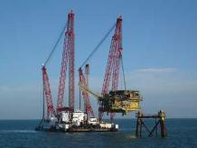
Decommissioning Costs
Worldwide, approximately 6,500 offshore installations are expected to be decommissioned by 2025; estimated decommissioning values in principal markets are:
North Sea: $40-50 billion
U.S. Gulf of Mexico: $40 to $50 billion
Asia-Pacific: $32 billion
Identified company challenges included the evolution from shallow water (<400 feet) to deepwater, safe execution of projects, budget forecasting, and deepwater topsides and subsea decommissioning
Notes:
Notable quotes:
“This business area is still new to contractors which will bring different challenges and new tools and techniques”
“Decommissioning is the highest risk work that our company does”
“Decommissioning is still in its infancy”
9

Slide 10
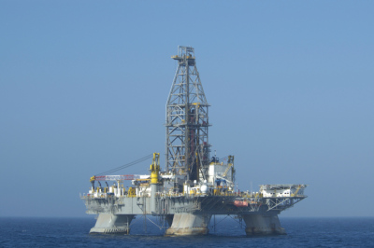
Operator Viewpoint: Decommissioning
Survey of over 100 decommissioning specialists in the Gulf of Mexico Region (GOMR) (Decomworld, Nov. 27, 2012)
Biggest challenges identified for the decommissioning sector in the Gulf of Mexico Region:
Lack of regulatory interaction;
Lack of experienced staff;
Lack of accurate cost estimations for decommissioning;
Lack of finances to carry out the work; and
Lack of suitable and experienced contractors.

Slide 11
Operational Risk Factors on the OCS
Large and increasing potential monetary liabilities
“Routine” GOMR decommissioning cost - $40 to $50 billion
Non-payment of rents and royalties managed by ONRR
Aging infrastructure
Current records indicate 813 “idle iron” platforms
Any operation that is decommissioned and is no longer “economically viable,” infrastructure that is severely damaged or idle infrastructure on active leases is considered “idle iron”
Increased demand for decommissioning as infrastructure ends its lifecycle
Exponential increase in the cost of decommissioning because of increased water depth
Company characteristics on OCS operations have changed
Large companies transfer sunset properties to smaller, less experienced companies
Less experienced organizations enter the decommissioning market

Slide 12
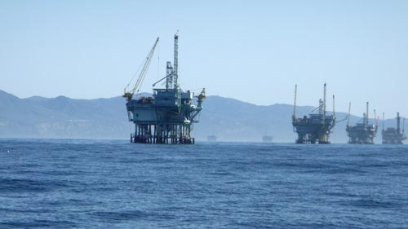
Operational Risk Factors on the OCS (continued)
Technological advances have outpaced existing regulations and policies
Necessity to update current bonding regulations
Lack of industry and governmental expertise in subsea decommissioning

Slide 13
Risk Management

Slide 14
Risk Management Program Requirements
Decrease cost risks to taxpayers from end-of-life/ownership issues, non-payment of royalties and rents, risky business practices, bankruptcies, and catastrophic risks
Encourage utilization of a variety of risk management strategies and instruments
Contain clear communication channels to identify, manage, and reduce the impact of risks
Provide access to comprehensive and updated information/data regarding health of offshore oil and gas companies (legal, technical, safety, and financial)
Safeguard stakeholders’ interests by implementing loss mitigation practices as well as identifying and managing risks
Notes:
14

Slide 15
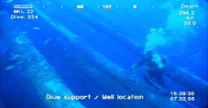
Examples of Factors/Events that Increase Risk Exposure
Complex financial arrangements
Weather events
Impending or actual bankruptcy action
Technological advances (e.g., deepwater operations)
Major engineering/technological failures
Equipment constraints and timing
Operator inexperience
Location (e.g., remoteness, proximity to environmentally sensitive locations)

Slide 16
Upstream Production and Exploration
Upstream production and exploration companies have risk ratings with very different factors than downstream refiners and integrated organizations that are involved in all phases of the industry (transportation, petrochemical)
Typically offshore upstream organizations have the greatest exploration risk and a much higher capital cost for each individual well (contrast to oil sands)
Conventional reserves have become more scarce
The overall resources base is depleting and there is a continued need for reinvestment in locating new reserves to replace and grow production in order to remain a viable company

Slide 17
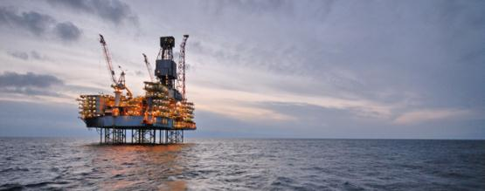
Costs and Availability of Resources
Upstream risk rating factors include significant volatility in prices that can be realized, high costs of locating, developing and producing reserves and uncertainty in estimates of recoverable reserves
Industry benefits from technological advances to improve recovery and make difficult reserves available for production

Slide 18
Risk Rating Factors
Typical risk ratings take note of above average industry profitability due to its overall contribution to the global economy (growth)
Risk ratings account for difficulty in reserve replacement
Some individual companies have stronger ratings due to their ability to create economies of scale and diversification
Risk ratings account for commodity price volatility that is high compared to other industries – the industry accounts for this volatility in their business planning

Slide 19
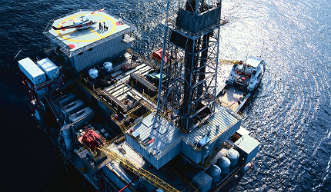
Risk Rating Factors
Regulations related to industry economic conditions are not typical in this market
Regulations for safety, permitting, environmental issues and reclamation are coming to the forefront in this market

Slide 20
Comprehensive Risk Analysis
Risk ratings are derived from combining information regarding long term company business risk (technical, environmental, engineering, location, facility age) plus company financial risk measured mainly by liquidity (liquidity gives financial flexibility)
A principal measure of liquidity or base levels of cash flow (shown by profit-earnings) is:
EBIT – earnings before interest and taxes or
EBITDA – earnings before interest and taxes plus non-cash items (DA) depreciation and amortization

Slide 21
Financial Assurance

Slide 22
Financial and Business Metrics
Risk factors to be analyzed include:
Operator cash flow
Debt-to-net present value of proved reserves
Water depth of facility
Age/type of facility
Operator experience
Insurance coverage
Site remoteness
Environmental sensitivity
Overall geographic spread of properties

Slide 23
Existing NTL
BOEM is in the process of updating existing NTL No. 2008-N07
The current process is designed to:
Utilize calculations to determine decommissioning liability
Determine risk regarding a given company's ability to meet its financial obligations
Specify types of security and other financial security needs
The need for additional bonding can always be required by the Regional Director to satisfy other obligations.
The overall objective of this review is to ensure coverage through supplemental bonds or other alternatives in amounts not less than the established cumulative decommissioning liability.
BOEM continues to reserve its right to take other actions to satisfy all lease obligations and to vary from procedures or criteria on a case-by-case basis.

Slide 24
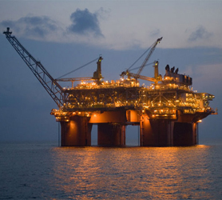
Performance Standard
The minimum performance standard at BOEM requires organizations have the "financial ability to ensure“ that:
wells plugged and abandoned
platforms removed
drilling and platform sites, including pipeline corridors, cleared of all obstructions

Slide 25
Determination of Financial Strength and Reliability in Existing NTL
The calculation in Section III determines financial strength with balance sheet calculations of greater than or equal to $65 Million and cumulative decommissioning liability of less than or equal to 50% of net worth.
AND EITHER the organization is producing 20,000 barrels of oil equivalent (BOE) per day (in the most recent 12 months of data) from OCS leases for which the lessee owns a record title interest
OR the organization provide independently audited financials indicating:
Total net worth $65-100 Million
AND cumulative decommissioning liability less than or equal to 25% of net worth, THEN the debt to equity ratio (total liability divided by net worth) must be less than or equal to 2.5
Where cumulative decommissioning liability is greater than 25% but less than or equal to 50% of net worth THEN debt to equity ratio (total liability divided by net worth) must be less than or equal to 2.0
Total net worth is above $100 Million
AND cumulative decommissioning liability less than or equal to 25% of net worth, THEN the debt to equity ratio (total liability divided by net worth) must be less than or equal to 3.0
Where cumulative decommissioning liability is greater than 25% but less than or equal to 50% of net worth THEN debt to equity ratio (total liability divided by net worth) must be less than or equal to 2.5

Slide 26
Determination of Financial Strength and Reliability in Existing NTL
BOEM may but is not required to consider:
EITHER
future net revenues associated with the value of proved producing reserves for all leases where a lessee owns record title interest equaling the percentage of their interest. (Up to 25% of reserve value can be used to calculate net worth)
OR
future net revenue associated with the value of proved producing reserves in calculating net worth by obtaining an independent 3rd party estimate of total proved producing reserves. (If value includes record title and operating rights interests, then up to 50% of the reserve value can be included in net worth calculation)
Following recent bankruptcy matters, these considerations will likely be revised to reflect difficulty in tracking offshore interests not currently in BOEM's system.
The NTL also contemplates BOEM's request for additional insured status and insurance for residual liabilities for both catastrophic events and non-payment.

Slide 27
Current Financial Strength & Reliability Determination
Example*: BOEMCO owns four leases:
 | Record Title | Producing | Decom Liability | “financially waived” co-Record Title owners
Lease 1 | 100% | Yes | $20,000,000 | 0
Lease 2 | 50% | Yes | $20,000,000 | 2
Lease 3 | 100% | No | $10,000,000 | 1
Lease 4 | 25% | No | $5,000,000 | 0
Total non-waived decommissioning liability | = | $25,000,000
Net worth | = | $200,000,000
Total non-waived decommissioning liability/Net worth | = | 12.5%
Total liabilities | = | $500,000,000
Debt/Equity | = | 2.5
BOEMCO demonstrates sufficient financial strength to defer its supplemental bonding obligations.
*According to traditional interpretation of NTL No. 2008-N07

Slide 28
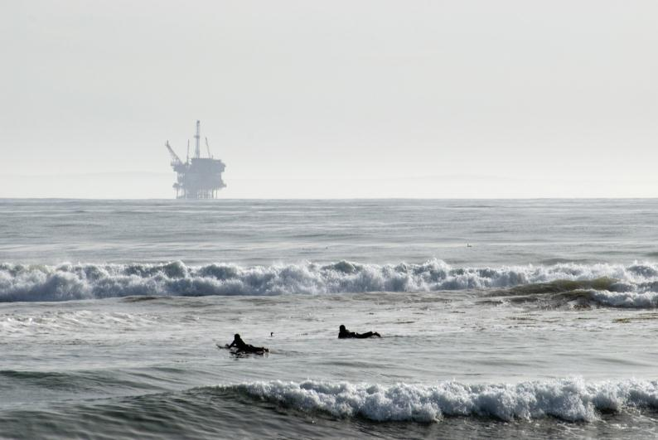
Summary

Slide 29
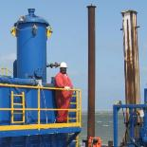
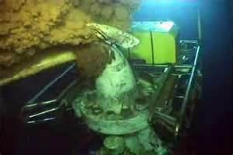
Developing Win-Win Solutions for Offshore Business Challenges
A comprehensive risk management and financial assurance program benefits regulators by reducing potential taxpayer liability
Front end risk management also provides operators negotiated solutions that improve business certainty and reduce litigation
A dynamic risk management and loss prevention program will assist regulators in balancing economic growth with the protection of natural resources

Slide 30
Questions?
Risk Management and Offshore Liability

